Slide 1

Machine Learning Model:
House Price Prediction
Team 8: Huiying Ba, Danting Huang, Ziqin Ma, Jiao Sun, Senbo Zhang

Slide 2
Data Preliminary
The dataset describes every aspect of residential homes in Ames, Iowa.
1460 observations with 81 columns, including character variables and numeric variables.
Without Id’s, the dataframe consists of 79 predictors and the response variable `SalePrice`
Numeric
Scale
(Quality and condition)
Type
(roof type, alley)

Slide 3
Data Cleaning
Numeric variables => column means
Type variables => string “N/A”
Scale variables => as a level of 0
Year Sold - Year Built = Age of property when sold
Year Sold - Year Remodeled = Remodeled age when sold
Year Sold - Garage Built = Garage of Age when dols
Converted to quarters (I, II, III, IV) as a categorical variable
Missing Value
Years
Months

Slide 4
Goal
Combine unsupervised/supervised techniques on past dataset to build a model that can estimate property prices with certain features
Provide information on factors/aspects that closely relates to the price in Ames, Iowa

Slide 5
Workflow
EFA
Train | Price
Type | Scale | Numeric
Test | Price Prediction
ID | Cluster | PCs | Price
Supervised
Model

Slide 6

Modeling

Slide 7
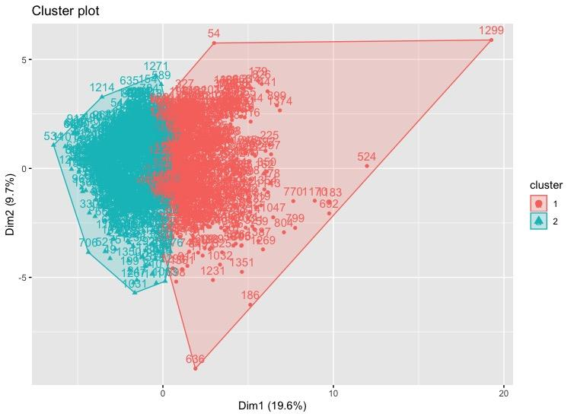
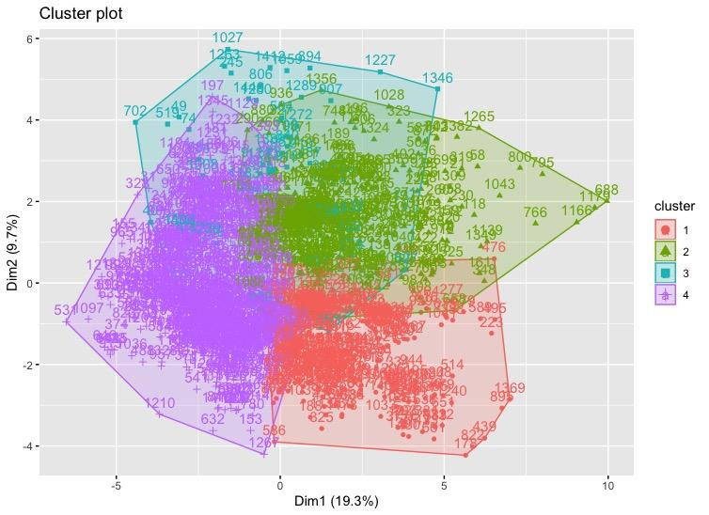
KMeans: identify outliers
Removing
Outliers
Will not use KMeans clusters to reduce dimensions
The main reason is removing outliers.

Slide 8
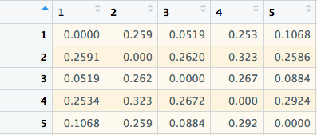
Partitioning using Gower Distance
Goal: want to reduce number of categorical columns
Gower Distance:
calculating distance in a mix of categorical and numerical variables
Dissimilarity matrix:
Pairwise dissimilarities among observations using Gower distance
0’s in diagonal

Slide 9
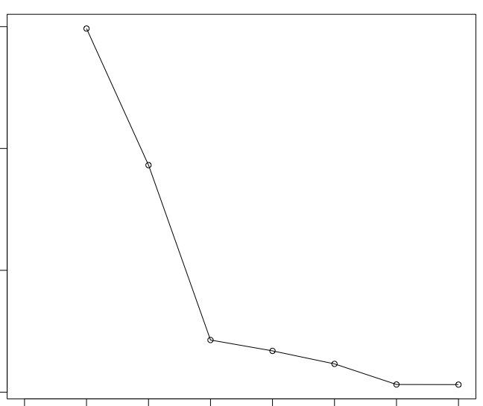
Partitioning using Gower Distance
Ran a function to find the optimal k with the highest average silhouette score
Choose k = 2

Slide 10
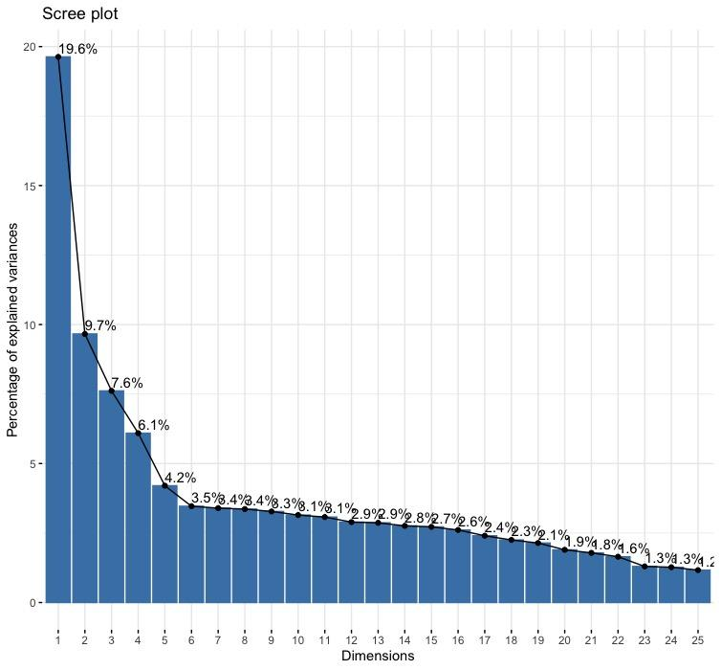
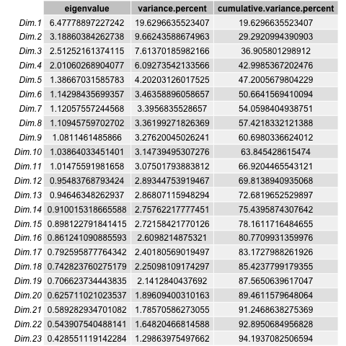
Principal Component Analysis
Scree plot
Eigenvalues
92.9%
Notes:
Wanna explains more variance for accuracting
Dim.1-Dim.12’s eigenvalues values greater than 1
First 22 PCA explaining nearly 93% of the variance
We predict PCs for each property and export these 22 columns for supervised models

Slide 11
ID | PCs | Cluster | Price
Model Input
Validation
New dataframe for supervised models

Slide 12
Supervised Techniques
LASSO/Random Forest/XGBoost
Compared MSE in validation sets
XGboost: accuracy of 87.59%
LASSO | Random Forest | XGBoost
1,244,322,758 | 1,136,864,724 | 854,295,790

Slide 13
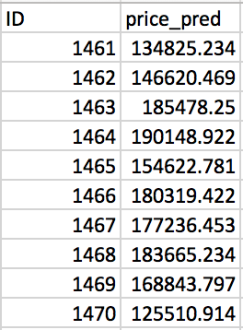
Running model on future data
Place your screenshot here
Input:
Original test dataset with 79 variables, no price column
Output:
ID + Price estimate

Slide 14
Inference: PC1 from LASSO
Age
House
Garage
Square feet
Living area
1st floor
Garage
Basement
Number of Rooms/facilities
Bedrooms
Fireplaces
Full bathrooms
Other rooms

Slide 15
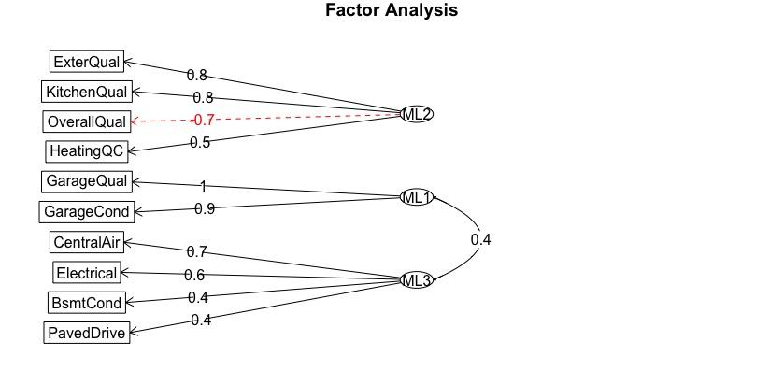
Inference: Factor Analysis
Qualities
Garage
Amenities
Notes:
Except for the high contribution variables from principal components, we also wanted to
find some underlying factors among scale variables by EFA.

Slide 16
Discussion
Limitations:
Loss of interpretability
Type variables aggregation
Alley access to property,
Paved driveway
Better approach with geographic data
43 character variables
clus
1
2

Slide 17
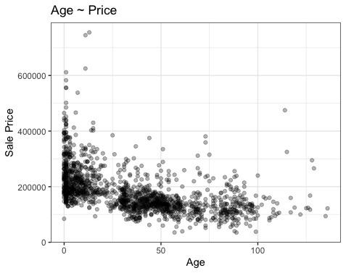
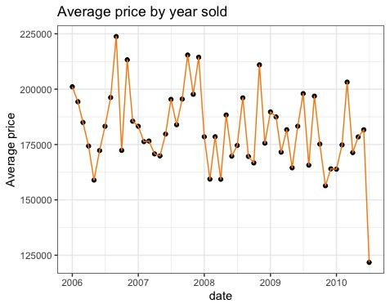
Evaluating Years
We parsed Year Sold into Age of property when sold

Slide 18
Applications
Sellers & Buyers
Price debrief of properties with similar features
Real estate agencies
Pricing constructions and significant factors

Slide 19
THANKS!
Any questions?
Github Repository:
https://github.com/ziqinm/BA-820-Project.git

